Slide 1


ENDODONTIC MISHAPS

Slide 2
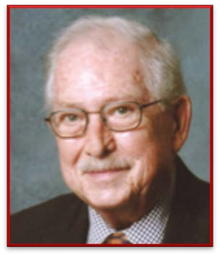

Endodontic mishaps or procedural accidents are those unfortunate occurrences that happen during treatment, some owing to inattention given to detail otherwise totally unpredictable.
INGLE:
Those unfortunate occurrences that happen during treatment, some owing to inattention to detail, others totally unpredictable.
WALTON & TORABINEJAD :
Unwanted or unforeseen circumstances during root canal therapy that can affect the prognosis.
2

Slide 3

Classification
According to Walton & Torabinejad
Procedural accidents during access preparation
Accidents during cleaning & shaping
  Ledge formation
  Creating an artificial canal
  Root perforations
  Separated instruments
  Other accidents
Accidents during obturation
  Underfilling
  Overfilling
  Vertical root fractures
4. Accidents during post space preparation
3

Slide 4
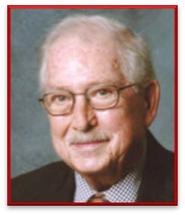
According to Ingle
Access related
  Treating the wrong tooth
  Missed canals
  Damage to existing restoration
  Access cavity perforations
  Crown fractures
Instrumentation related
  Ledge formation
  Cervical canal perforations
  Midroot perforations
  Apical perforations
  Separated instruments and foreign objects
  Canal blockage
Obturation related
Over or underextended root canal fillings
Nerve paresthesia
Vertical root fractures
III.
Miscellaneous
  Post space perforation
  Irrigant related
  Tissue emphysema
  Instrument aspiration and ingestion
4

Slide 5
MANAGEMENT OF A MISHAP
I. Recognition of a mishap - be by radiograph or clinical observation or as a result of a patients complain……
II. Correction of a mishap - depending on the type and extend of procedural accident
III. Re-evaluation of the prognosis tooth involved
IV. How to prevent a mishap
5

Slide 6
When an accident occurs during root canal treatment -The patient should be informed about
The incident
Procedures necessary for correction
Alternative treatment modalities
The effect of this accident on prognosis

Slide 7
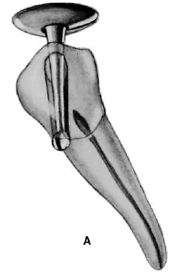
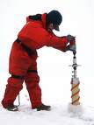
ACCESS RELATED MISHAPS

Slide 8
Cause
Inattention on the part of the dentist
Misdiagnosis
Patient continues to have symptoms after treatment
Error may be detected after the rubber dam has been removed.
Recognition
Correction
Appropriate treatment of both teeth:
The one incorrectly opened
The one with the original pulpal problem

Slide 9
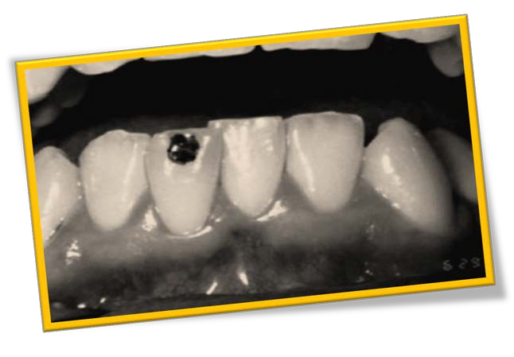
PREVENTION
Mistakes in diagnosis can be avoided by obtaining at-least 3 good pieces of evidence supporting the diagnosis.
Obtaining as much information as possible before making the diagnosis.
Marking the tooth to be treated before isolating it with rubber dam.

Slide 10
Mistakes in diagnosis can be avoided by, obtaining at least three good pieces of evidence supporting the diagnosis
Radiograph showing a tooth with an apical lesion.
Lack of response to electric pulp testing
Draining sinus tract leading to the tooth apex proved radiographically with a GP point inserted in the tract.

Slide 11
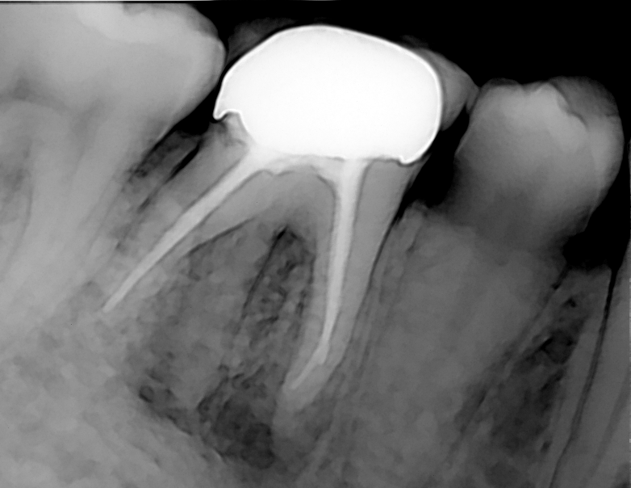
MISSED CANALS
Cause
Some root canals are not readily apparent or easily accessible
Anatomical
Lack of knowledge about root canal anatomy.
Failure to adequately search for these additional canals.
Failure to remove cervical ledges - prevents straight line entry into the canal or cover up additional canals
Dentist Related

Slide 12
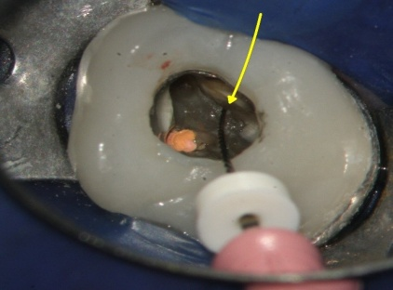
Recognition
During treatment, an instrument or filling material may be noticed to be other than exactly centered in the root.
Some cases, recognition may not occur until failure is detected.
Mesial roots of maxillary molars and distal roots of mandibular molars - commonly missed canals.
NaOCl can be used to detect canals – effervescence test
Retreatment is appropriate and should be attempted before recommending surgical correction.
Correction

Slide 13
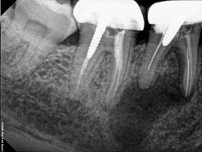
PROGNOSIS
Prognosis is reduced - most likely result in treatment failure
PREVENTION
Significant amount of failure are due to missed canals
Thorough knowledge of the morphology of the tooth
Interpretation of radiographs through mesial / distal angulation
Computerized digital radiography, magnifying loupes, microscopes, endoscopes.
Adequate coronal access - Follow principles of access cavity preparation
DG-16 explorer / Micro openers

Slide 14
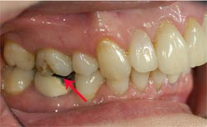
DAMAGE TO EXISTING RESTORATIONS
Endo-treatment of a tooth with existing porcelain crown is challenging.
Crown may chip off even with the most careful approach
While preparing access cavity
Placing rubber dam clamp on the margins
Correction
Minor porcelain chips can be at times repaired by bonding composite resin to crown

Slide 15
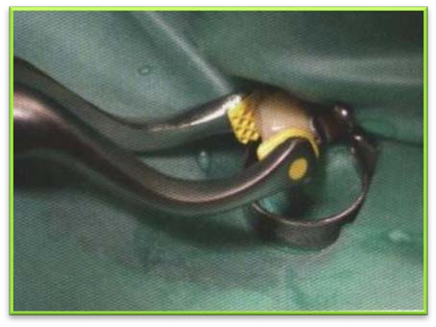
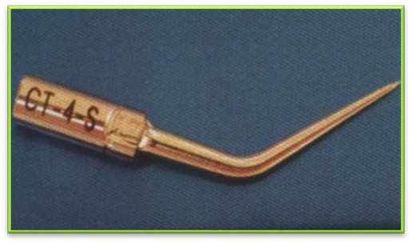
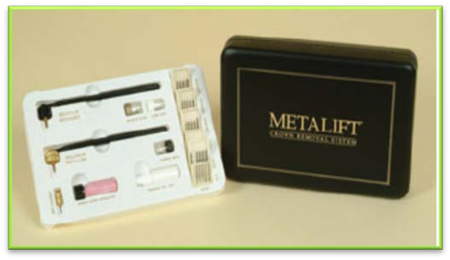
PREVENTION
Avoiding placing clamp directly on the margin
Remove permanently cemented crown before treatment
The rubber dam is released from the wings and positioned with the rubber between the jaws of the retainer and the restoration to provide a buffer.
Specialized crown pliers can be used to remove restorations
Remove crown with special device called Metalift crown and bridge system
Ultrasonic Vibration

Slide 16
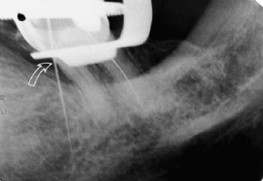
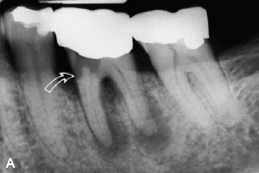
ACCESS CAVITY PERFORATIONS
Happens during the search for canal orifices.
Can occur either peripherally through the sides of the crown or through furcation.
Recognition
If the access cavity perforation is
  Presence of leakage into the access cavity is often the first indication of an accidental perforation.
Above PDL attachment
Into PDL
  Bleeding into the access cavity is often the first indication of an accidental perforation.

Slide 17
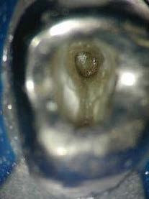
Cause
Failure to identify the angle of the crown to the root and the angle of the tooth in the dental arch.
  Ex:
Access through crowned teeth.
Maxillary lateral incisors and mandibular first premolars
Using a surgical length bur
Misidentification of canals

Slide 18
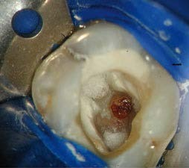
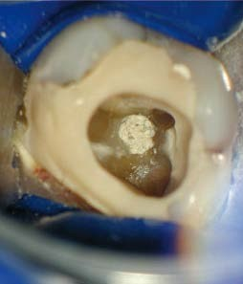
Correction
Coronal walls above the alveolar crest – can be repaired intracoronally without surgical intervention.
Perforations into periodontal ligament – should be done as early as possible to minimize injury to the tooth’s supporting tissues.
Materials used for these perforations
  - GIC, MTA, Super EBA, Tricalcium phosphate, Calcium hydroxide paste, amalgam or haemostatic agents such as gel foam.

Slide 19
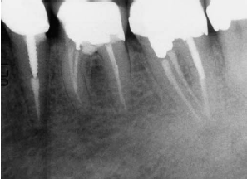
Prognosis
  Location
  Time
  Adequacy of seal
  Perforation size
  Accessibility to main canals
  Location
  Time
  Adequacy of seal
  Perforation size
Depends on:

Slide 20
PREVENTION
Proper bur alignment with the long axis of the tooth
Bur penetration for both depth and angulation can be confirmed with radiographs
Knowledge about the morphology
Adequate access preparation

Slide 21
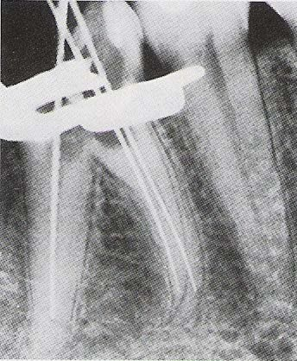

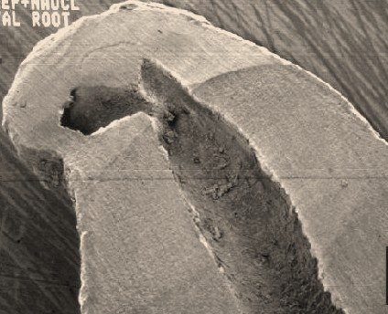
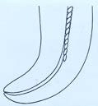
LEDGE FORMATION
INSTRUMENTATION RELATED MISHAPS
An artificially created irregularity on the surface of the root canal wall that prevents the placement of instruments to the apex of an otherwise patent canal.

Slide 22
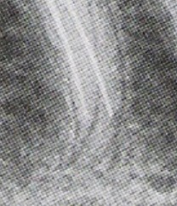
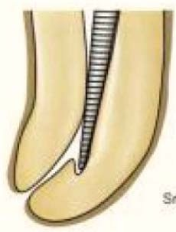
RECOGNITION
Root canal instrument can no longer be inserted into the canal to full working length.
Loss of tactile sensation of the tip of the instrument binding in the lumen.
Instrument point hitting against a solid wall
Radiograph with instrument in place.

Slide 23
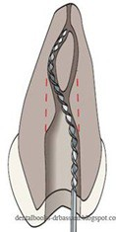
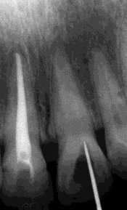
Cause
Inadequate access preparation
Inadequate irrigation / lubrication
Excessive enlargement of curved canal with files
Packing debris in the apical portion of the canal
Anatomic complexities - roots curved towards the buccal or lingual side.
Unsuspected canal aberrations in canal anatomy
Forcing and driving the instrument into the canal
Attempting to retrieve broken instruments
Attempting to prepare calcified root canals

Slide 24
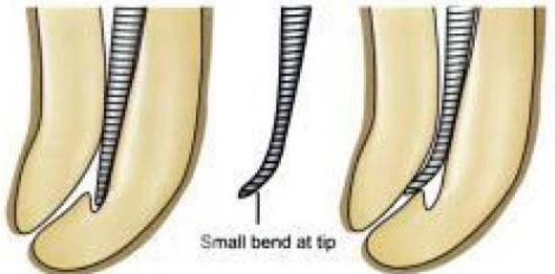
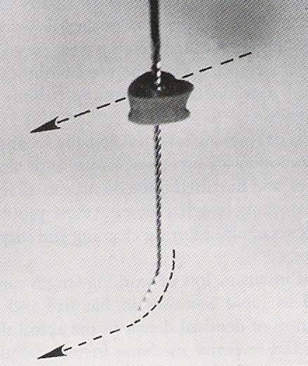
Correction
Locating the ledge
Irrigate, smaller instruments are preferred.
No. 10 or 15 with a distal curve at the tip can be used
Pointed towards the wall opposite to the ledge
“Tear shaped” silicone stops can be used.
Watch-winding motion
If resistance is felt, retract slightly, rotate and advance again,until it bypasses and reach apically.
Confirmed with a radiograph
If ledge cannot be bypassed, then clean, shape and obturate till obstruction.

Slide 25
CORRECTION
Alternative treatment procedures includes
Retrograde filling through surgery
Hemisection / apisectomy
Intentional replantation
Extraction

Slide 26
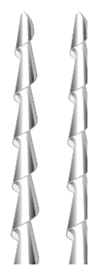
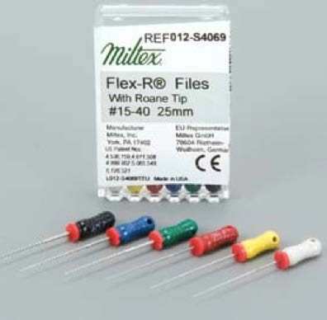
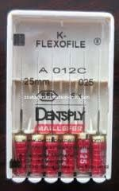
PREVENTION
Proper examination of the diagnostic radiographs.
Awareness of canal morphology
Frequent recapitulation and irrigation
Precurving the instrument and not forcing it.
Using instruments with not cutting tip
Using NiTi files in case of curved canals
  Flex R files
  Safety Hedstrom files
  Flexofile
Modified instruments:

Slide 27
Prognosis
Failure of root canal associated with ledging depends upon:
Amount of debris left in the un instrumented canal
Unfilled portion of the canal

Slide 28
ROOT PERFORATIONS
Perforations in all locations can be caused by 2 main errors
Creating a ledge in the canal wall during initial preparation and perforating through the side of the root at the point of obstructions / root curvature.
Using too large or too long an instrument and either perforating directly through the apical foramen or wearing a hole in the lateral surface of the root by over instrumentation.

Slide 29
Perforations can be either
Cervical
Middle
Apical

Slide 30
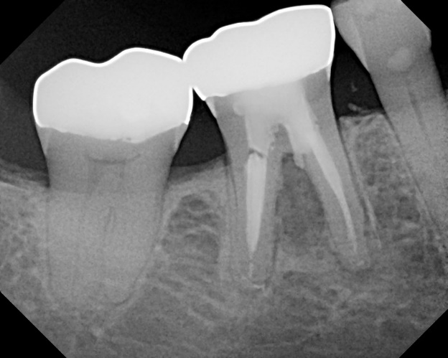
CERVICAL CANAL PERFORATION
Locating and widening the canal orifice.
Inappropriate use of Gates-Glidden burs.
Cause
Sudden appearance of blood.
Magnification with either loupes, an endoscope, or a microscope is very useful.
Confirmed : place a small file and take a radiograph of the tooth.
Recognition

Slide 31
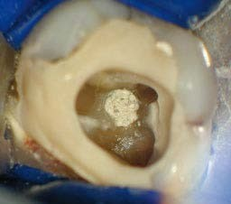
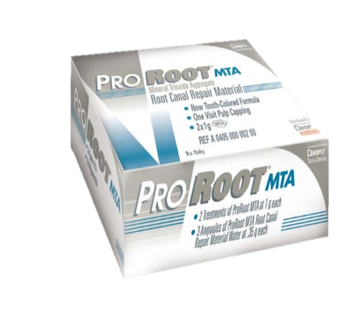
Correction
Hemostatics to control bleeding.
Small area : sealed from inside the tooth
Large area : seal from inside, then surgical repair
Materials used:
  Calcium Hydroxide, Collagen, Calcium Sulfate, Freeze-dried Bone, MTA
Where esthetics
is a concern, a calcium sulfate barrier along with composite restoration is generally used
Super EBA have been used when esthetics not an issue.
Presently MTA is rapidly becoming the barrier/ restorative of choice for repairing non- esthetic coronal one-third defects because of its many desirable attributes.

Slide 32
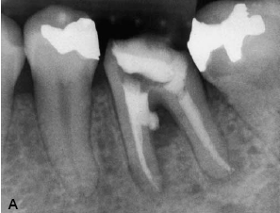
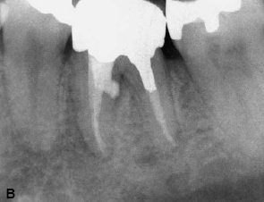
Prognosis
Usually Reduced
Surgical correction is required if a lesion / symptoms develops.
Size
Location
Length of time
Ability to seal
Accessibility to main canal
Existing periodontal condition
Depends on

Slide 33
Prevention
Reviewing each tooth’s morphology prior to entering its pulp space.
Thorough examination of pre-operative radiographs is the paramount step to avoid this mishap.
Checking the long axis of the tooth and aligning the long axis of the access bur with the long axis of the tooth - tipped tooth.
Following principles of access cavity preparation, adequate size and location, both permitting direct access to the root canals.

Slide 34
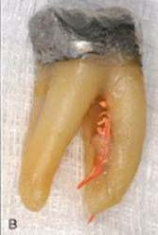
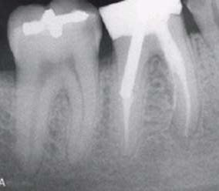
Mid-Root Perforation
Cause
Perforating when a ledge has formed
Along the inside curvature of the root as the canal is straightened out - canal stripping “
(Ex: Distal wall of the mesial root of the mandibular first molar)
Difficult access
Limited visibility
Uncertainity of moisture free environment

Slide 35
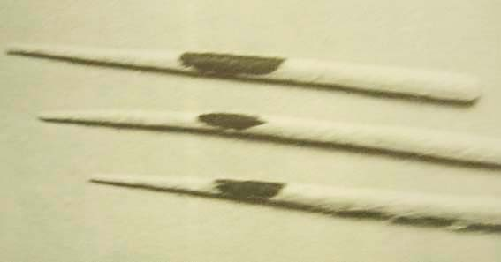
Recognition
Stripping is easily detected by the sudden appearance of hemorrhage in a previously dry canal.
Sudden complaint by the patient.
Paper points placed into the canal
Apex locators

Slide 36

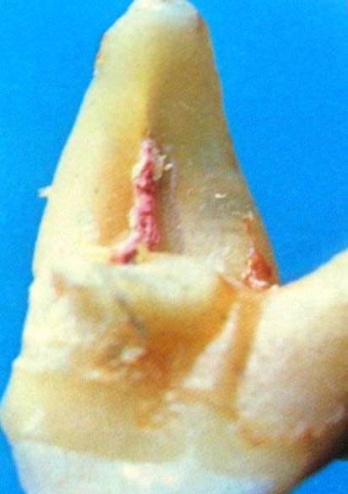
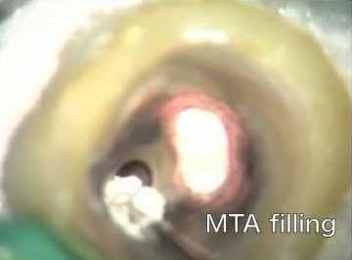
CORRECTION
These defects are ovoid in shape and typically represent relatively large surface area to seal.
Access to midroot perforation is most often difficult, and repair is not predictable.
Successful repair depends upon the adequacy of the seal established by the repair material.
The repair should be immediate, to protect the perforated site from saliva and other contaminants.
Barrier material of choice is MTA.
Two-step method: canals obturated and then defect is repaired surgically

Slide 37
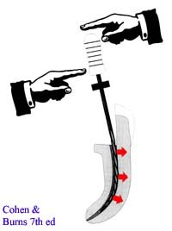
PROGNOSIS
Usually Reduced
Chances of micro-leakage / fracture
Prevention
Careful use of rotary instruments.
Anticurvature filing

Slide 38

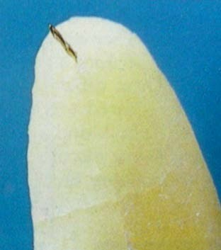
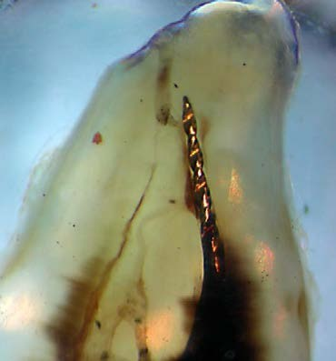
APICAL PERFORATION
Cause
Straight canal
Curved canal
:- Inaccurate WL & instrumenting beyond apex
- Ledging, Apical Transportation or Apical Zipping
Recognition
Patient suddenly complains of pain during treatment.
Canal becomes flooded with hemorrhage.
If tactile resistance of the confines of the canal space is lost.
Confirmation by radiograph.
A paper point inserted to the apex will confirm a suspected apical perforation.

Slide 39

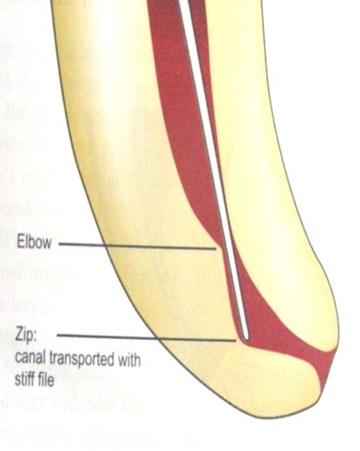
Zipping (Elliptication)
Transportation of the apical portion of the canal
ie. an elliptical shape formed in the apical foramen during preparation of curved canals.
The terms ‘teardrop’ and ‘hour-glass shape’ are used to describe the resulting shape of the zipped apical part of the root canal
Creation of an ‘elbow’ is associated with zipping – at the narrow region of the root canal at the point of maximum curvature
Ie. the irregular widening that occurs coronally along the inner aspect and apically along the outer aspect of the curve.

Slide 40
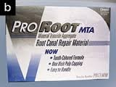
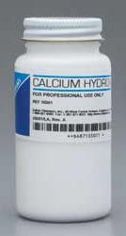
CORRECTION
Overinstumentation :
Re-establish the WL and enlarge with larger instrument.
Apical barrier: Ca(OH)₂, MTA, Dentin Chips, Hydroxyapatite
Apical Perforation :
  Negotiate
  Perforation
site as the new apical opening and obturation is
done to seal of the foramen.
Surgery is necessary, if a lesion present apically.

Slide 41
Surgical Approach:
A combined intracoronal and surgical approach involves repairing the defect intracoronally, then reflecting a surgical flap to remove the inevitable overextension of the repair material from the periodontal space.
In case of failing furcation repairs
Bicuspidation
Hemi-Section
Intentional Replantation
can be considered as treatment options.

Slide 42
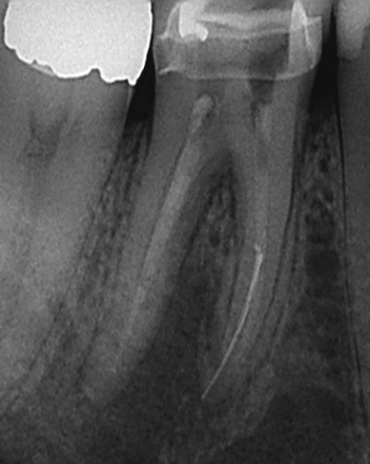
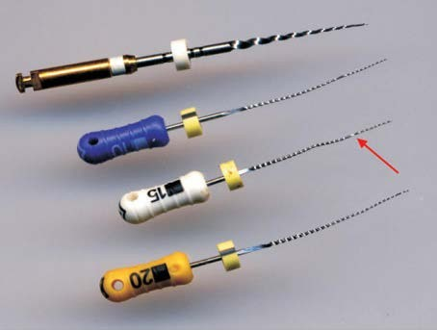
Instrument Separation
Files & Reamers – most commonly involved
Using a Stressed instrument
Placing exaggerated bends
Forcing a file before canal has been opened sufficiently.
Inadequate access
Anatomy of the canal
Instrument is advanced into the canal until it binds, and efforts to remove it .
Manufacturing defects
Cause

Slide 43
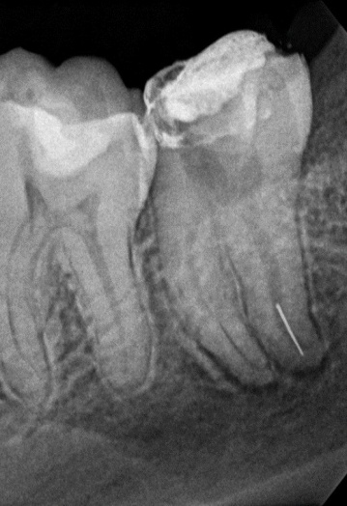
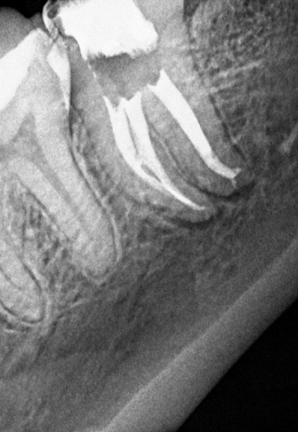
RECOGNITION
Loss of WL
Shortened instrument
Radiographic confirmation
CORRECTION
There are three approaches to treatment.
Attempt to remove the instrument
Attempt to by pass it
Prepare and obturate up to the separated segment.
It will vary depending upon the location and nature of the broken instrument.

Slide 44



If one third of the overall length of an obstruction can be exposed and /or
  Instrument that lie in the straight portion of the canal : Retrieval Is Possible.
Instrument lies partially around the canal curvature and if access can be established to its most coronal extent : removal is Difficult But Still Possible.
If the entire segment of the broken instrument is apical to the curvature if the canal and safe access cannot be accomplished : Removal Impossible.

Slide 45

RETRIEVAL TECHNIQUES
Checking for the mobility of the instrument
If lying loosely in the coronal third-
Using microscopes, K files or H files are placed between the instrument and the dentinal wall, to bypass the obstacle.
NaOCl and urea peroxide – Effervescence Or Bubbling Effect makes the instrument to float.
Grasping the file - Micro Needle Forceps, Steiglitz / a Hemostat

Slide 46



RETRIEVAL TECHNIQUES
Wedged instruments in coronal third
Masseran KIT
Useful for removing metallic objects from root canals.
It contains a series of tubular trephine drills,& 2 sizes of tubular excavator.
  Technique
  First creating a space in the root canal around the coronal 2 mm of the metallic object, so that the excavator tube will pass over it.
  Then the excavator plugger, a locking rod in the tube is screened down, locking the metallic object against a knurled ring in the tube wall.
  This mechanism provides adequate retention for removal of most metallic object and instruments.

Slide 47



Instrument Retrieval System (IRS)
Endo extractors :
They grasp the instrument with cyanoacrylate and not by friction.
Endo safety system:
  Also uses trephine burs.
  These trephines are smaller in diameter & the extractors use different mechanisms for grasping instruments

Slide 48



Ultrasonic instruments
  Different sizes and angles of ultrasonic tips are available for this purpose.
  Ex: ProUltra Endo: 1,2,3 ; ProUltra Endo: 6, 7, 8
  The tip is placed on the staging platform between the exposed end of the file and the canal wall.
  Precisely removes dentin and progressively exposes the coronal aspect of the fractured file.
  Vibration in CCW direction applies unscrewing force to the file that will aid in loosening the file.
  Occasionally they will appear to jump out of the canal
  It is wise to keep cotton or paper points in other canals to prevent the removed fragment from falling into them.

Slide 49
Middle 1/3 of the canal
Micro needle forceps and H file
Ultrasonic tips such as Slim Jim ,CT4 & UT4 can be used.
Apical Third
Instruments cannot be grasped directly.
Drilling with instruments remove excess dentin
Use of RC prep /NaOCl
H file
Sonic instrumentation

Slide 50
Failing to retrieve the instrument :
Within the canal : Bypassed
  Canal is filled
  But risk of perforation
Within the canal : Cannot be bypassed
  Prepare and fill the canal till the level of separation
  Instrument seals close to the apex and apical area is normal, then keep under evaluation.
  If area of rarefaction persists, then apical surgery.
If instrument extends pass the apex
  Cleaning, shaping and filling
  Apical surgery and retro-filling if indicated

Slide 51

PREVENTION
Examine new instruments - defects
Careful handling
Stressed instrument - DISCARD
Instruments No. 6, 8 and 10 should be examined carefully to check for signs of stress and should be used only once.
Use of canal lubricants
Follow sequential instrumentation
Major concern with NiTi instruments, tend to fracture without warning.

Slide 52


Obstruction in a previously patent canal that prevents access to the apical stop
Canal Blockage / Blockout
Cause
Files compact apical debris (dentin chips)
Fibrous blockage (tissue debris)
Fractured instrument / restorative material / paper point / cotton
Recognition
Working length no longer attained.
Confirmed radiographically

Slide 53


CORRECTION
Recapitulation – quarter turn with EDTA
Precurving and Redirecting the instrument
Still if the block cannot be bypassed, endosonics can be used to dislodge dentin debris by acoustic streaming.
Forcing any instrument may further compact the debris or may lead to perforation.
Prognosis
Depends on the stage of instrumentation, disinfection and cleaning.
Vitality of the pulp

Slide 54
PREVENTION
Remove all caries and restorations before completion of the access cavity preparation.
All instruments must be wiped clean before introducing it into the canals
Frequent use of irrigation
Instruments should not be used in dry canal
Recapitulation
Sequential instrumentation
Excessive pressure and rotation should be avoided

Slide 55


CAUSE
Obturation Related Mishaps
Over/Under Extended Root Canal Fillings
Under extension :
  Failure to fit mastercone accurately
  Poorly prepared canal apically
Over extension :
  Apical perforation with loss of constriction
Recognition - Post-op radiographs

Slide 56
Correction
Under extension :
  Retreatment
Over extension :
  More difficult
  Successful if the entire GP is removed in one tug
  Gutta-percha and many sealers - generally well tolerated and do not automatically require surgical removal.
  If symptoms persist - surgical removal

Slide 57



Vertical Root Fractures
Can occur in any phase of therapy, while instrumentation, obturation / post placement
Recognition
Sudden crunch sound
Pain reaction
A suggestive “tear drop” radiolucency
Deep periodontal pocket of recent origin in a tooth with long present root canal filling
Exploratory surgery is a good way to visualize fracture.

Slide 58
MANAGEMENT
Most cases, extraction is the only option.
Hemisection / Root Amputation of the fractured root may be considered.
Prevention
Avoid weakening of canal wall. (Over-preparation of canals)
Passive obturation and post placement
Full cuspal coverage
Minimize internal wedging forces

Slide 59



RECOGNITION
Post space perforation
Sudden presence of blood in the canal
Radiographic evidence
Presence of sinus tract stroma eluding to the base of a post.
Management - Sealing of the perforation if possible

Slide 60

Prognosis
Least effect if perforation is within bone
If in gingival sulcus, then periodontal breakdown occurs
There is a 15% failure rate in areas other than furcation. (Rud J et al)
Prevention
Good knowledge of root canal anatomy
Planning the post space preparation based on radiographic information
Preparing the space at the time the root canal is obturated.
GG drills / Peeso reamers can be used

Slide 61



MISCELLANEOUS
Instrument Aspiration & Ingestion
When used in the absence of a rubber dam, instruments can accidentally be aspirated or dropped into the mouth.
Recognition - Radiographs of the chest and abdomen
Management
In the dental operatory –
Removal of accessible objects
High-volume suction
Hemostats and cotton pliers
Once aspirated – Emergency Medical Attention
61

Slide 62

PREVENTION
Proper tooth isolation with rubber dam
Tying a floss to the rubber dam clamp and endodontic files before use.
62

